Slide 1
How can we increase revenue
from
Catch the Pink Flamingo?
MICHAEL VENTURA

Slide 2
Problem Statement
Increasing Revenue
Unlock the power of the data and the analytics to identify new revenue opportunities and gain insight into player behaviors.
Data Source:
Players activities during the game
Chats between Players
MICHAEL VENTURA
Notes:
Fill in appropriate data set descriptions.
In your script, be sure to make clear how this is a data science story. State in your own words YOUR opinion of why the different kinds and sources of data are so important for Eglence to be able to identify new revenue opportunities.

Slide 3
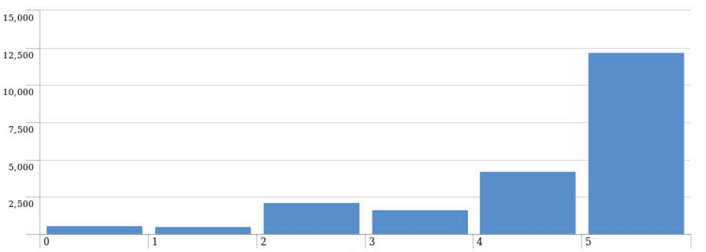
Data Exploration Overview
Increasing Revenue
Revenue Generated from in-App Purchase Items
5th item generated the 57% of total revenue. More than other items combined
Revenue
Item
MICHAEL VENTURA
Notes:
Assuming you have <2 minutes for this slide, what is the most important thing(s) to convey from your experience with exploring the data?

Slide 4
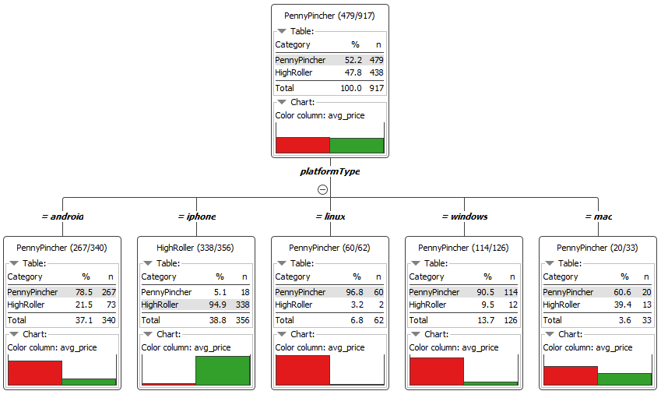
What have we learned from classification?
Increasing Revenue
Users of iPhone are a great target focus
MICHAEL VENTURA
Notes:
Assume you have 2 minutes to present what you perceive to be the most important or remarkable points from your classification analysis.

Slide 5
What have we learned from clustering?
Increasing Revenue
Cluster | Cluster Center
1 | [41.07, 10.29, 145.51]
2 | [34.25, 6.45, 67.22]
3 | [26.30, 4.48, 17.07]
totalAdClicks: Total number of ad-clicks per user
totalRevenue: Total money spent on in-app purchase items per user
totalBuyClicks: Total number of in-app purchase per user
MICHAEL VENTURA
Notes:
Assume you have 2 minutes to present what you perceive to be the most important or remarkable points from your classification analysis.

Slide 6
From our chat graph analysis, what further exploration should we undertake?
Increasing Revenue
Found the longest conversation chain and its participants
Analyzed relationship between Top10 chattiest users and Top10 chattiest teams
Found the Top3 most active users based on clustering coefficient
MICHAEL VENTURA
Notes:
Assume you have 2 minutes to present what you perceive to be the most important or remarkable points from your graph analysis

Slide 7
Recommendation
Increasing Revenue
Focus on selling and developing in-app purchase items like the 5th item
Promoting the game to attract more IOS and Mac users
Target specific group of players obtained from the results of clustering and graph analysis
MICHAEL VENTURA
Notes:
From your own viewpoint, make one recommendation/action the Eglence should follow to improve their business. Be sure to explain your rationale.

